Slide 1
validation
Taught by Yossef Ayman Zedan

Slide 2
Custom styles
For custom Bootstrap form validation messages, you’ll need to add the novalidate boolean attribute to your <form>. This disables the browser default feedback tooltips, but still provides access to the form validation APIs in JavaScript. Try to submit the form below; our JavaScript will intercept the submit button and relay feedback to you. When attempting to submit, you’ll see the :invalid and :valid styles applied to your form controls.
Custom feedback styles apply custom colors, borders, focus styles, and background icons to better communicate feedback. Background icons for <select>s are only available with .form-select, and not .form-control.
Add this Javascript code to make the validation work:
(function () { 'use strict' // Fetch all the forms we want to apply custom Bootstrap validation styles to var forms = document.querySelectorAll('.needs-validation') // Loop over them and prevent submission Array.prototype.slice.call(forms) .forEach(function (form) { form.addEventListener('submit', function (event) { if (!form.checkValidity()) { event.preventDefault() event.stopPropagation() } form.classList.add('was-validated') }, false) }) })()

Slide 3
Basic Example
<form class="row g-3 needs-validation" novalidate> <div class="col-md-4"> <label for="validationCustom01" class="form-label">First name</label> <input type="text" class="form-control" id="validationCustom01" value="Mark" required> <div class="valid-feedback"> Looks good! </div> </div> <div class="col-md-4"> <label for="validationCustom02" class="form-label">Last name</label> <input type="text" class="form-control" id="validationCustom02" value="Otto" required> <div class="valid-feedback"> Looks good! </div> </div>

Slide 4
Basic Example
<div class="col-md-4"> <label for="validationCustomUsername" class="form-label">Username</label> <div class="input-group has-validation"> <span class="input-group-text" id="inputGroupPrepend">@</span> <input type="text" class="form-control" id="validationCustomUsername" aria-describedby="inputGroupPrepend" required> <div class="invalid-feedback"> Please choose a username. </div> </div> </div> <div class="col-md-6"> <label for="validationCustom03" class="form-label">City</label> <input type="text" class="form-control" id="validationCustom03" required> <div class="invalid-feedback"> Please provide a valid city. </div> </div>

Slide 5
Basic Example
<div class="col-md-3"> <label for="validationCustom04" class="form-label">State</label> <select class="form-select" id="validationCustom04" required> <option selected disabled value="">Choose...</option> <option>...</option> </select> <div class="invalid-feedback"> Please select a valid state. </div> </div> <div class="col-md-3"> <label for="validationCustom05" class="form-label">Zip</label> <input type="text" class="form-control" id="validationCustom05" required> <div class="invalid-feedback"> Please provide a valid zip. </div> </div>

Slide 6
Basic Example
<div class="col-12"> <div class="form-check"> <input class="form-check-input" type="checkbox" value="" id="invalidCheck" required> <label class="form-check-label" for="invalidCheck"> Agree to terms and conditions </label> <div class="invalid-feedback"> You must agree before submitting. </div> </div> </div> <div class="col-12"> <button class="btn btn-primary" type="submit">Submit form</button> </div> </form>

Slide 7
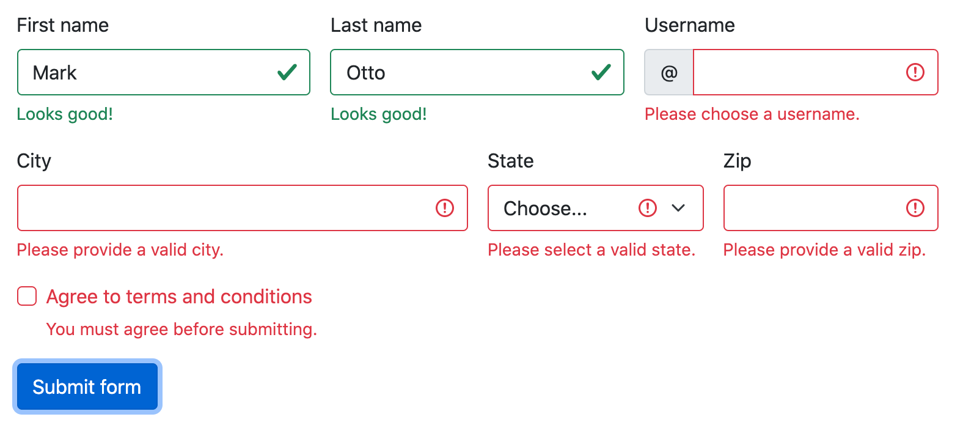
Basic Example

Slide 8
Browser defaults
Not interested in custom validation feedback messages or writing JavaScript to change form behaviors? All good, you can use the browser defaults. Try submitting the form below. Depending on your browser and OS, you’ll see a slightly different style of feedback.
While these feedback styles cannot be styled with CSS, you can still customize the feedback text through JavaScript.
Delete validations and feedbacks

Slide 9
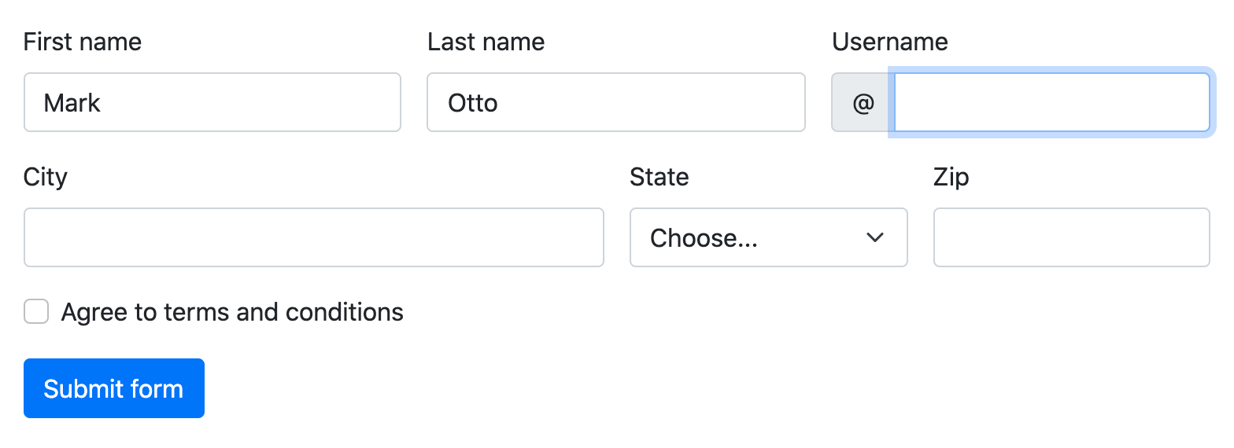
Browser defaults

Slide 10
Server side
We recommend using client-side validation, but in case you require server-side validation, you can indicate invalid and valid form fields with .is-invalid and .is-valid. Note that .invalid-feedback is also supported with these classes.
Source code:
<form class="row g-3"> <div class="col-md-4"> <label for="validationServer01" class="form-label">First name</label> <input type="text" class="form-control is-valid" id="validationServer01" value="Mark" required> <div class="valid-feedback"> Looks good! </div> </div>

Slide 11
Server side
<div class="col-md-4"> <label for="validationServer02" class="form-label">Last name</label> <input type="text" class="form-control is-valid" id="validationServer02" value="Otto" required> <div class="valid-feedback"> Looks good! </div> </div> <div class="col-md-4"> <label for="validationServerUsername" class="form-label">Username</label> <div class="input-group has-validation"> <span class="input-group-text" id="inputGroupPrepend3">@</span> <input type="text" class="form-control is-invalid" id="validationServerUsername" required> <div id="validationServerUsernameFeedback" class="invalid-feedback"> Please choose a username. </div> </div> </div>

Slide 12
Server side
<div class="col-md-6"> <label for="validationServer03" class="form-label">City</label> <input type="text" class="form-control is-invalid" id="validationServer03" required> <div id="validationServer03Feedback" class="invalid-feedback"> Please provide a valid city. </div> </div> <div class="col-md-3"> <label for="validationServer04" class="form-label">State</label> <select class="form-select is-invalid" id="validationServer04" required> <option selected disabled value="">Choose...</option> <option>...</option> </select> <div id="validationServer04Feedback" class="invalid-feedback"> Please select a valid state. </div> </div>

Slide 13
Server side
<div class="col-md-3"> <label for="validationServer05" class="form-label">Zip</label> <input type="text" class="form-control is-invalid" id="validationServer05" required> <div id="validationServer05Feedback" class="invalid-feedback"> Please provide a valid zip. </div> </div> <div class="col-12"> <div class="form-check"> <input class="form-check-input is-invalid" type="checkbox" value="" id="invalidCheck3" required> <label class="form-check-label" for="invalidCheck3"> Agree to terms and conditions </label> <div id="invalidCheck3Feedback" class="invalid-feedback"> You must agree before submitting. </div> </div> </div>

Slide 14
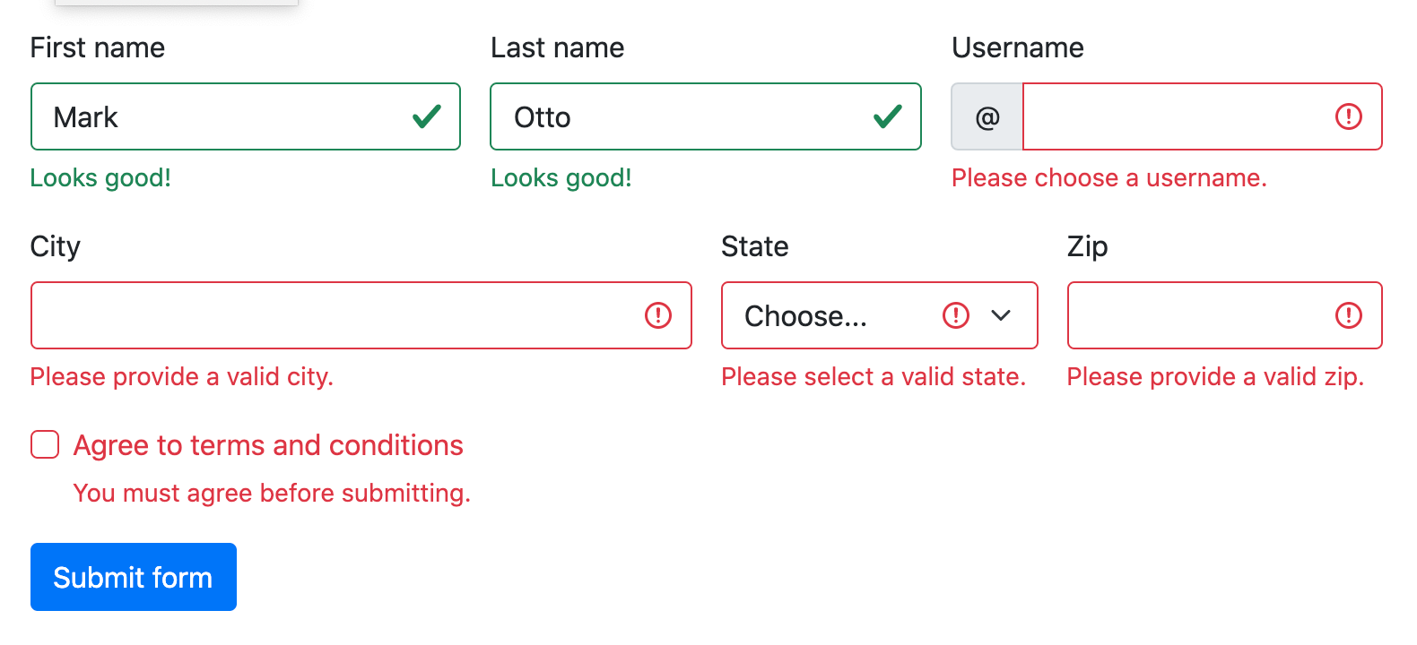
Server side
<div class="col-12"> <button class="btn btn-primary" type="submit">Submit form</button> </div> </form>

Slide 15
Supported elements
Validation styles are available for the following form controls and components:
<input>s and <textarea>s with .form-control (including up to one .form-control in input groups)
<select>s with .form-select
.form-checks
Source code:
<form class="was-validated"> <div class="mb-3"> <label for="validationTextarea" class="form-label">Textarea</label> <textarea class="form-control is-invalid" id="validationTextarea" placeholder="Required example textarea" required></textarea> <div class="invalid-feedback"> Please enter a message in the textarea. </div> </div>

Slide 16
Supported elements
<div class="form-check mb-3"> <input type="checkbox" class="form-check-input" id="validationFormCheck1" required> <label class="form-check-label" for="validationFormCheck1">Check this checkbox</label> <div class="invalid-feedback">Example invalid feedback text</div> </div> <div class="form-check"> <input type="radio" class="form-check-input" id="validationFormCheck2" name="radio-stacked" required> <label class="form-check-label" for="validationFormCheck2">Toggle this radio</label> </div> <div class="form-check mb-3"> <input type="radio" class="form-check-input" id="validationFormCheck3" name="radio-stacked" required> <label class="form-check-label" for="validationFormCheck3">Or toggle this other radio</label> <div class="invalid-feedback">More example invalid feedback text</div> </div>

Slide 17
Supported elements
<div class="mb-3"> <select class="form-select" required > <option value="">Open this select menu</option> <option value="1">One</option> </select> <div class="invalid-feedback">Example invalid select feedback</div> </div> <div class="mb-3"> <input type="file" class="form-control" required> <div class="invalid-feedback">Example invalid form file feedback</div> </div> <div class="mb-3"> <button class="btn btn-primary" type="submit" disabled>Submit form</button> </div> </form>

Slide 18
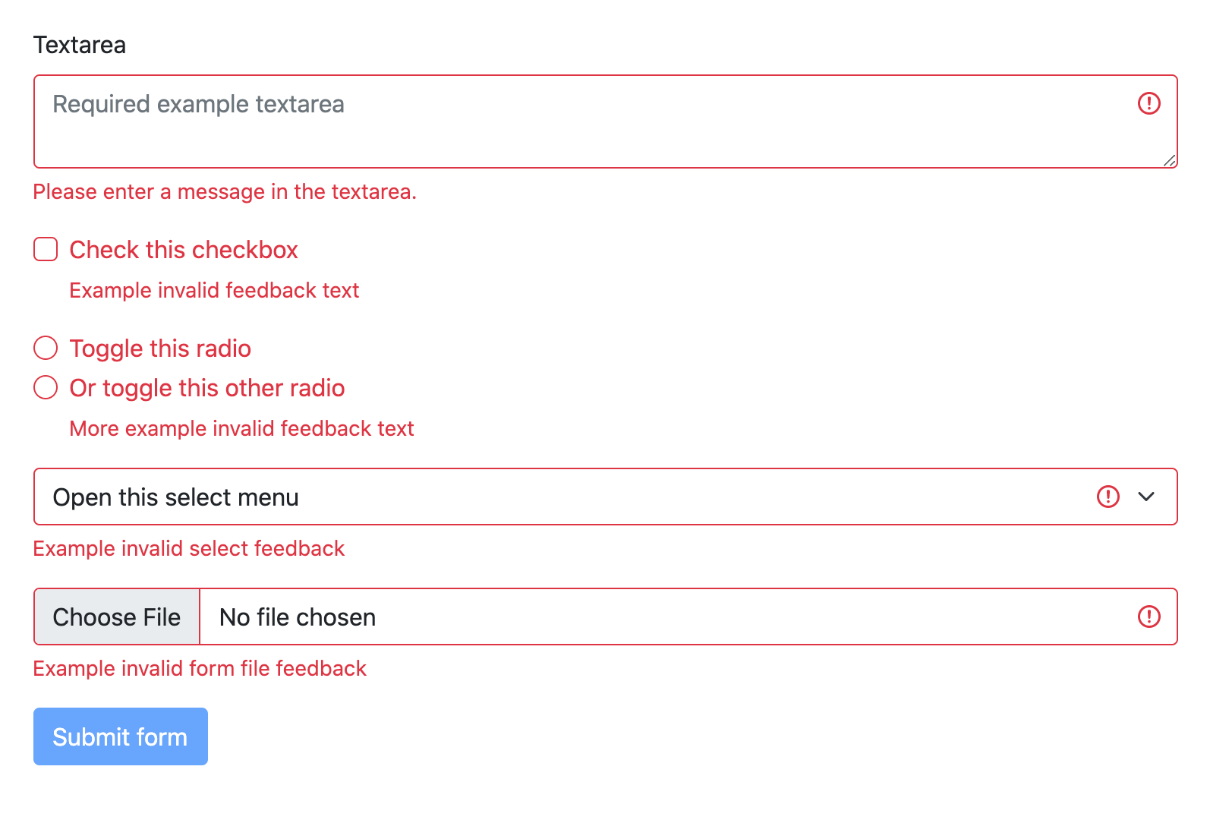
Supported elements

Slide 19
Tooltips
If your form layout allows it, you can swap the .{valid|invalid}-feedback classes for .{valid|invalid}-tooltip classes to display validation feedback in a styled tooltip. Be sure to have a parent with position: relative on it for tooltip positioning. In the example below, our column classes have this already, but your project may require an alternative setup.
<form class="row g-3 needs-validation" novalidate> <div class="col-md-4 position-relative"> <label for="validationTooltip01" class="form-label">First name</label> <input type="text" class="form-control" id="validationTooltip01" value="Mark" required> <div class="valid-tooltip"> Looks good! </div> </div>

Slide 20
Tooltips
<div class="col-md-4 position-relative"> <label for="validationTooltip02" class="form-label">Last name</label> <input type="text" class="form-control" id="validationTooltip02" value="Otto" required> <div class="valid-tooltip"> Looks good! </div> </div> <div class="col-md-4 position-relative"> <label for="validationTooltipUsername" class="form-label">Username</label> <div class="input-group has-validation"> <span class="input-group-text" id="validationTooltipUsernamePrepend">@</span> <input type="text" class="form-control" id="validationTooltipUsername” required> <div class="invalid-tooltip"> Please choose a unique and valid username. </div> </div> </div>

Slide 21
Tooltips
<div class="col-md-6 position-relative"> <label for="validationTooltip03" class="form-label">City</label> <input type="text" class="form-control" id="validationTooltip03" required> <div class="invalid-tooltip"> Please provide a valid city. </div> </div> <div class="col-md-3 position-relative"> <label for="validationTooltip04" class="form-label">State</label> <select class="form-select" id="validationTooltip04" required> <option selected disabled value="">Choose...</option> <option>...</option> </select> <div class="invalid-tooltip"> Please select a valid state. </div> </div>

Slide 22
Tooltips
<div class="col-md-3 position-relative"> <label for="validationTooltip05" class="form-label">Zip</label> <input type="text" class="form-control" id="validationTooltip05" required> <div class="invalid-tooltip"> Please provide a valid zip. </div> </div> <div class="col-12"> <button class="btn btn-primary" type="submit">Submit form</button> </div> </form>

